Slide 1
Analysis of Improving the spatial solution of electrocardiographic imaging: A new regularization parameter choice technique for the Tikhonov method by J Chamorro-Servent
Kutay Uğurlu

Slide 2
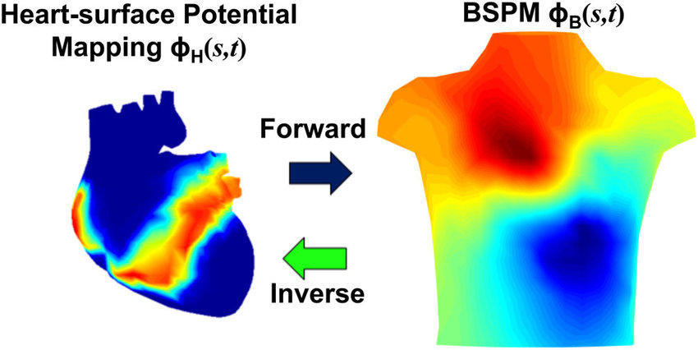
ECGI Inverse Problem

Slide 3
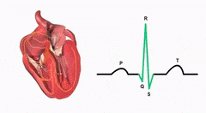
Ill-posedness
Noise on the measured torso potentials
Uncertainty in the location of measurement sites with respect to the source locations
Errors of segmentation of the geometry
Influence of the cardiac motion

Slide 4
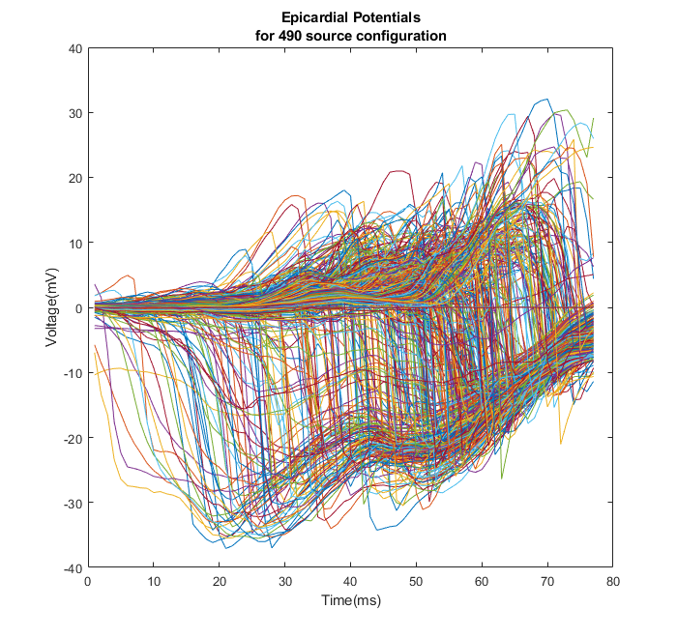
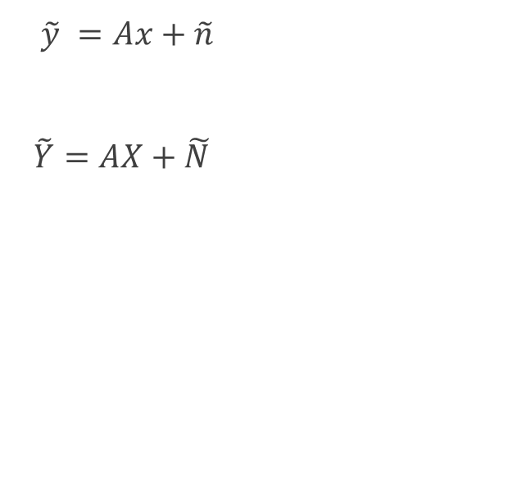
Formulation
$\tilde{y} =Ax+\tilde{n}$
$\tilde{Y}=AX+\tilde{N}$

Slide 5
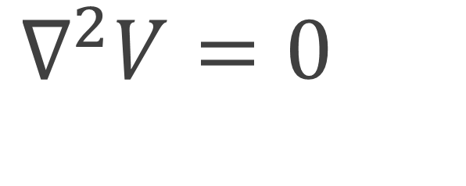
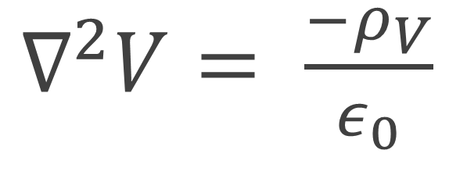
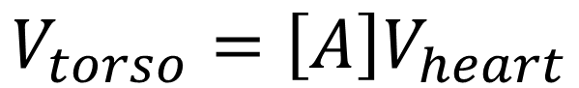
Laplace Equation
$∇^{2}V= \frac{−ρ_{V}}{ε_{0}}$
No source
$∇^{2}V=0$
Green’s Second Theorem
$$V_{torso}=\left[A\right]V_{heart}$$

Slide 6
Methods
Forward Model: Method of Fundamental Solutions (MFS)
Inverse Solution: Tikhonov Regularization

Slide 7
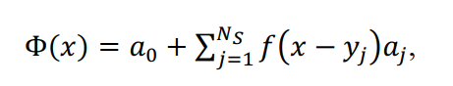
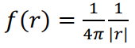
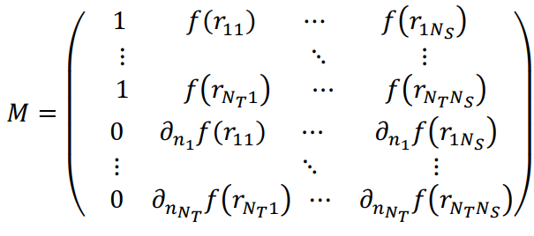
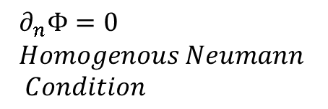
Method of Fundamental Solutions
$$∂_{n}Φ=0 \\ Homogenous Neumann \\ Condition$$

Slide 8
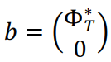
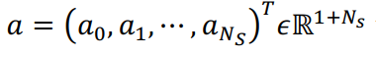
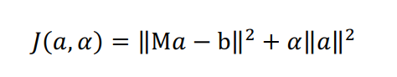
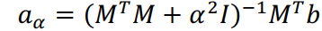
Tikhonov Regularization Formulation

Slide 9
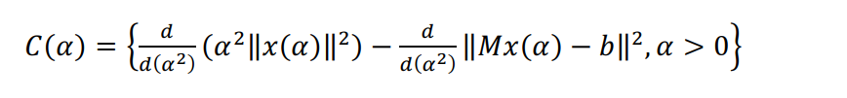
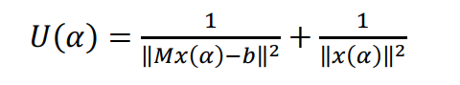
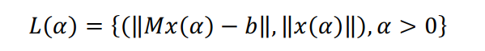
Choice of Regularization Parameter α
CRESO
L-Curve
U-Curve
Automated Discrete Picard Condition **

Slide 10
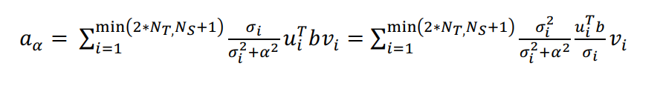
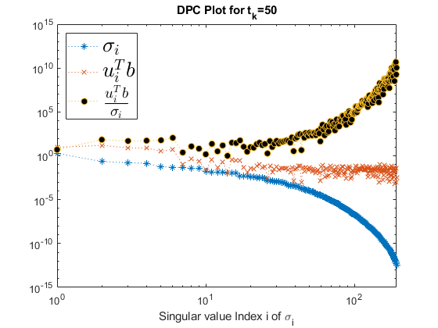
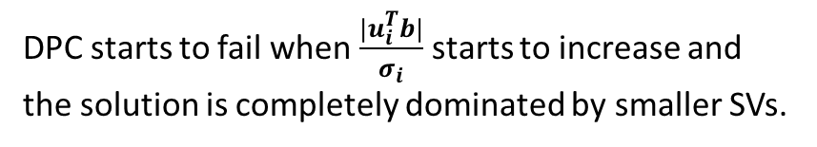
Discrete Picard Condition
DPC starts to fail when $\frac{|u_{i}^{T}b|}{σ_{i}}$ starts to increase and the solution is completely dominated by smaller SVs.
Notes:
That is, the 𝜎𝜎𝑖𝑖 above the regularization parameter 𝛼𝛼 (useful SVs) must decay to zero slower than the corresponding right hand side coefficients, | 𝑢𝑢𝑖𝑖𝑇𝑇𝑏𝑏|

Slide 11
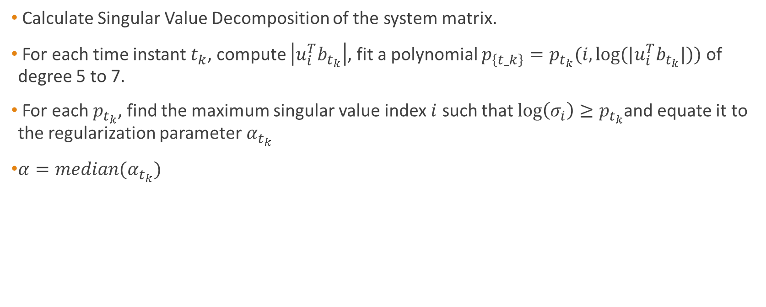
Automated Discrete Picard Condition (ADPC)
Calculate Singular Value Decomposition of the system matrix.
For each time instant $t_{k}$, compute $\left|u_{i}^{T}b_{t_{k}}\right|$, fit a polynomial $p_{\left\{t_k\right\}}=p_{t_{k}}(i,log⁡(|u_{i}^{T}b_{t_{k}}|))$ of degree 5 to 7.
For each $p_{t_{k}}$, find the maximum singular value index $i$ such that $\log\left(σ_{i}\right)≥p_{t_{k}}$and equate it to the regularization parameter$α_{t_{k}}$
$α=median(α_{t_{k}})$

Slide 12
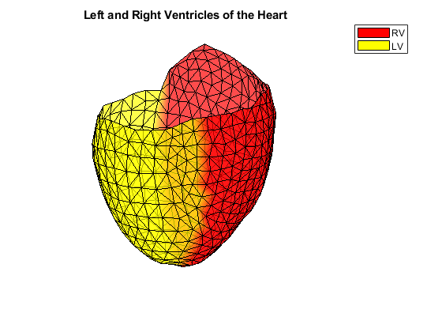
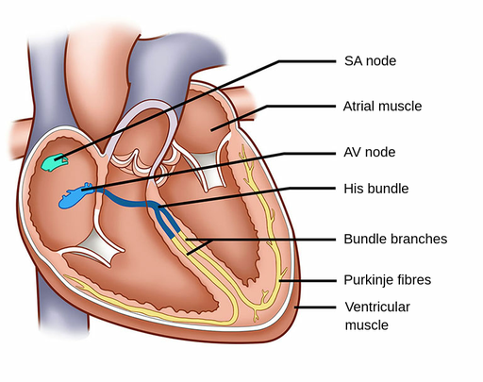
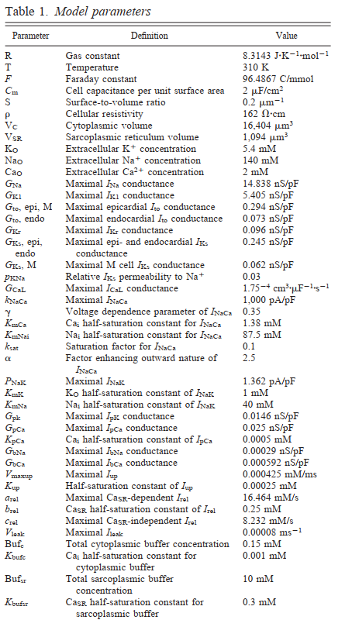
Dataset Generation
To test the effect of the new regularization parameter choice method and to compare with previous ones, eight different activation patterns (1 single site pacing in the right ventricular (RV) free wall, 1 single site pacing in the left ventricular (LV) lateral endocardial wall, 1 single site pacing in the LV mid wall, 1 single pacing site in the LV lateral epi and 4 single spiral waves) were simulated [19]. Propagating activation was simulated with a monodomain reaction-diffusion model in a realistic 3D model of the human ventricles, with transmembrane ionic currents computed with the Ten Tusscher et al. model for the human ventricular myocyte.

Slide 13
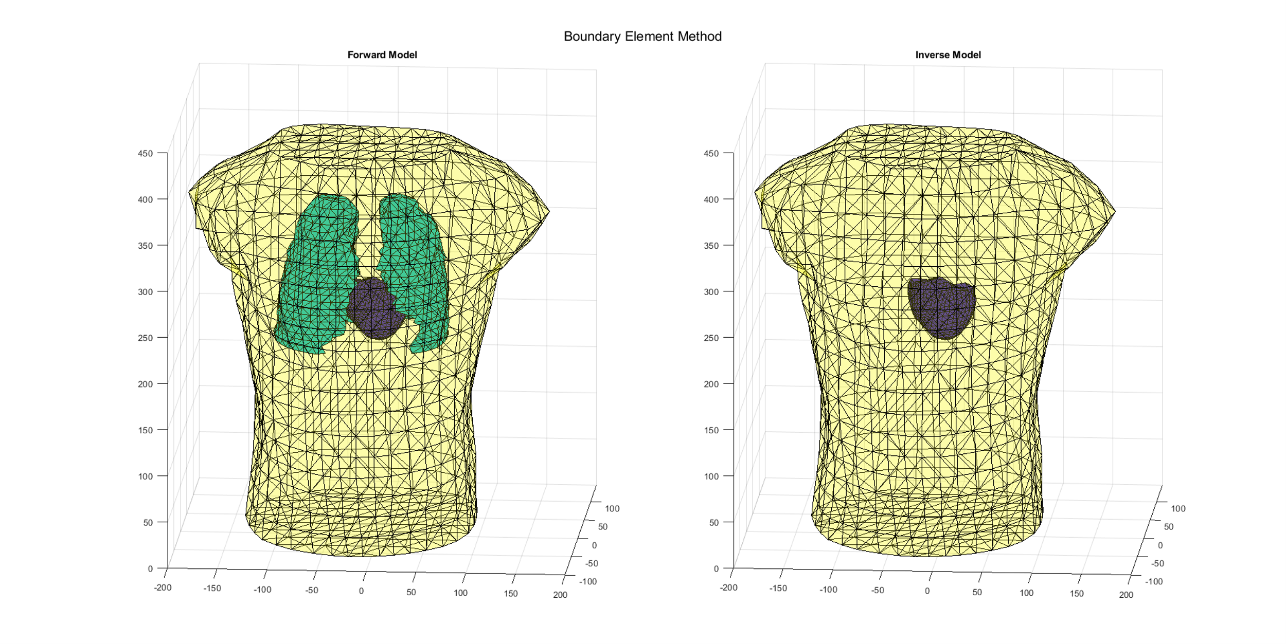
Boundary Element Method

Slide 14
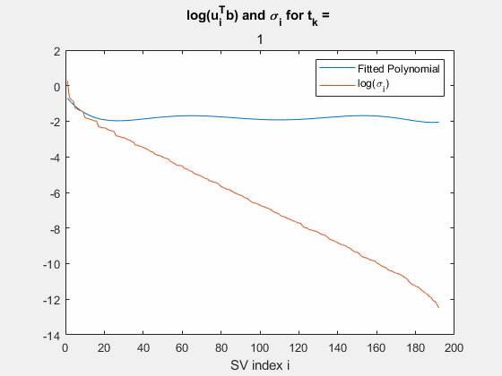
Modifications in the implementation

Slide 15
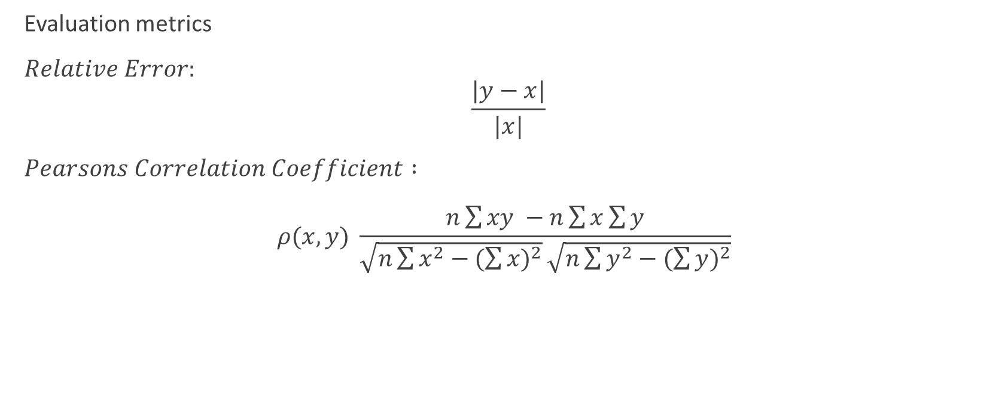
Results
Evaluation metrics
$Relative Error:$ $\frac{|y−x|}{|x|}$
$Pearsons Correlation Coefficient :$ $ρ(x,y) \frac{n\sum{xy −n\sum{x}\sum{y}}}{\sqrt{n\sum{x^{2}−{(\sum{x})}^{2}}}\sqrt{n\sum{y^{2}−{(\sum{y})}^{2}}}}$

Slide 16
Temporal
Spatial

Slide 17
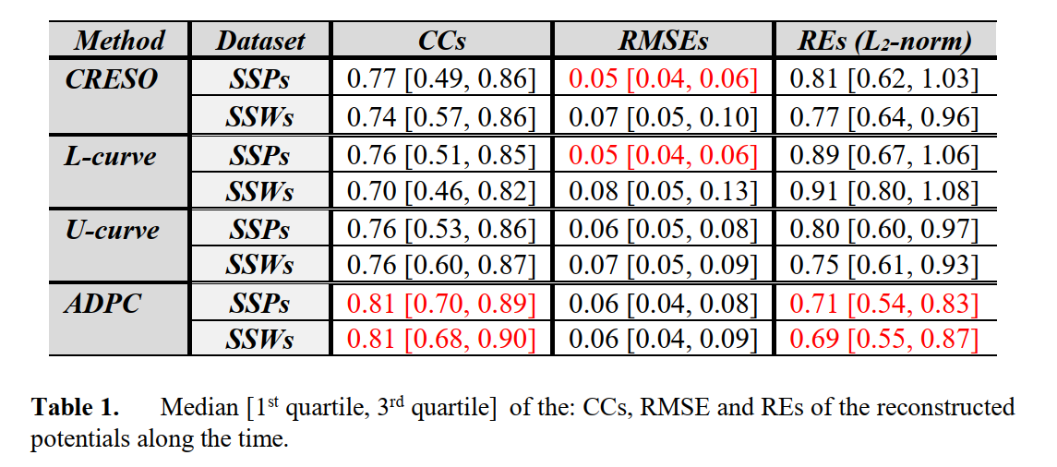

Slide 18
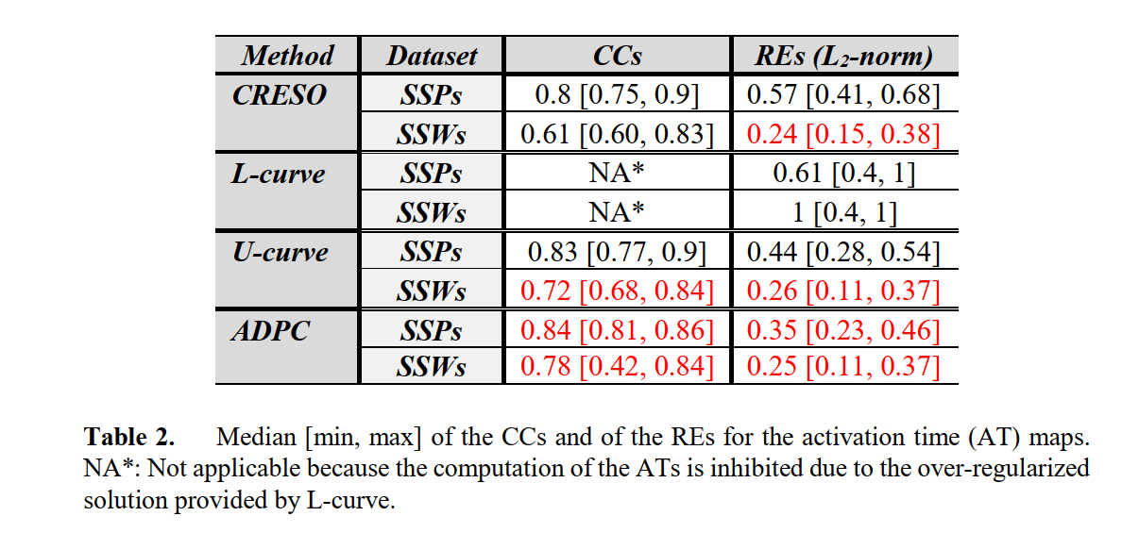

Slide 19
ADPC vs L-Curve Results for ADPC Ratio: 10
ADPC vs L-Curve Results for ADPC Ratio: 12.5
Simulations run on 16 different beats
Simulations run on 16 different beats
ADPC vs L-Curve Results for ADPC Ratio: 15
Simulations run on 16 different beats
1
1
0.9
0.9
0.9
0.85
0.8
0.8
0.8
Method Names
Method Names
0.7
ADPC
0.75
Method Names
0.7
ADPC
Metric Values
L-Curve
ADPC
Metric Values
Metric Values
L-Curve
0.7
L-Curve
0.6
0.6
0.65
0.5
0.5
0.6
0.4
0.4
0.55
CC
Metrics
RE
CC
Metrics
RE
CC
RE
Metrics
ADPC vs L-Curve Results for ADPC Ratio: 17.5
ADPC vs L-Curve Results for ADPC Ratio: 20
Simulations run on 16 different beats
Simulations run on 16 different beats
0.9
0.9
0.85
0.85
0.8
0.8
0.75
Method Names
0.75
Metric Values
ADPC
Method Names
0.7
L-Curve
Metric Values
ADPC
0.7
L-Curve
0.65
0.65
0.6
0.55
0.6
0.55
CC
Metrics
RE
CC
Metrics
RE

Slide 20
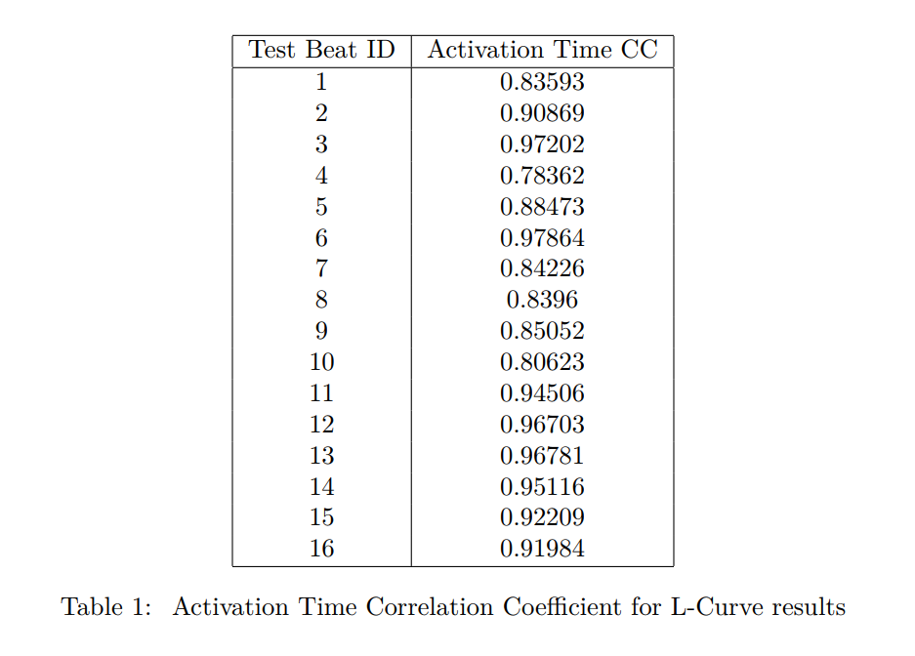
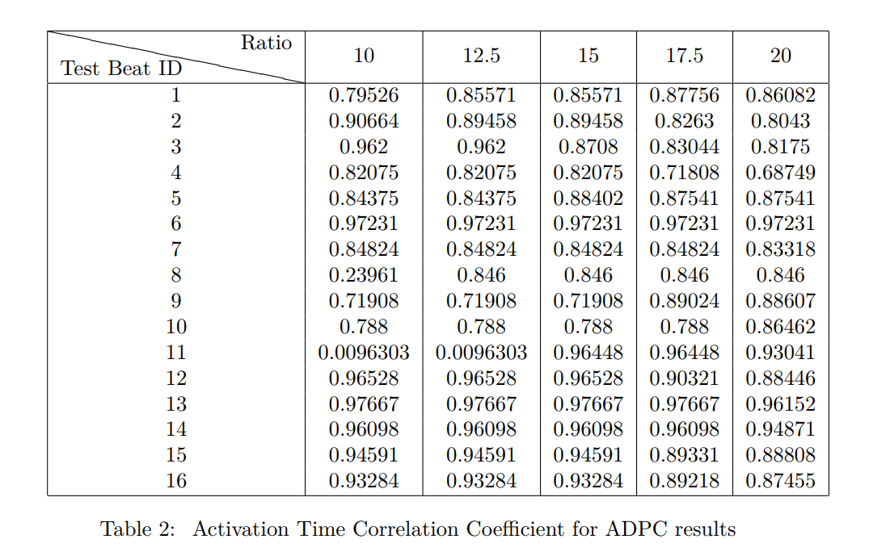
Activation Time Maps

Slide 21

References
“Figure 2. the illustration of forward and inverse ECG problems.” [Online]. Available: https://www.researchgate.net/figure/The-illustration-of-forward-and-inverse-ECG-problems_fig2_344270543. [Accessed: 29-Jun-2022].
Theory.labster.com. 2022. Sinoatrial node - Labster Theory. [online] Available at: <https://theory.labster.com/si_node/> [Accessed 29 June 2022].
“ECGI methodology,” Wustl.edu. [Online]. Available: https://rudylab.wustl.edu/research/noninvasive-electrocardiographic-imaging-ecgi/ecgi-methodology/. [Accessed: 29-Jun-2022].
R. S. MacLeod, B. Taccardi and R. L. Lux, "Electrocardiographic mapping in a realistic torso tank preparation," Proceedings of 17th International Conference of the Engineering in Medicine and Biology Society, 1995, pp. 245-246 vol.1, doi: 10.1109/IEMBS.1995.575092.

